Slide 1
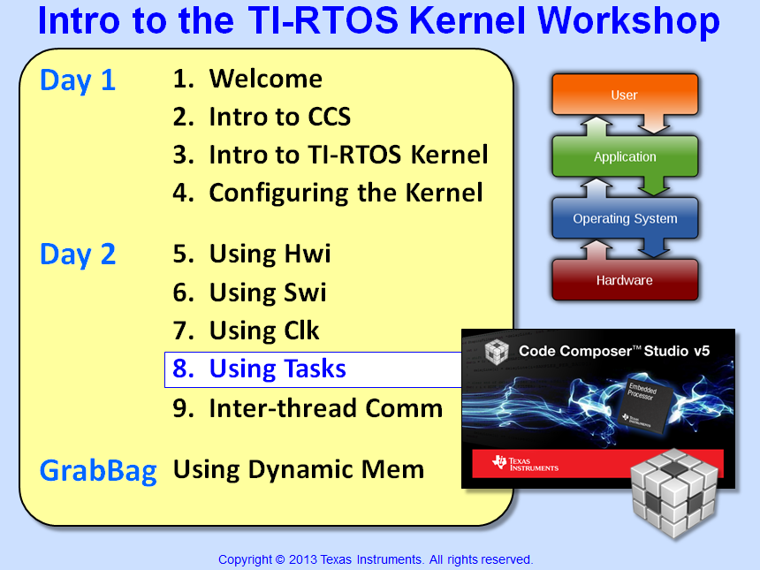

Slide 2
Objectives
Describe the use of Semaphores and Tasks in a system & how to configure them in BIOS
Compare/contrast Swi vs. Task
Identify how Tasks are prioritized within the BIOS Scheduler
Lab 8 – Use a Task to perform LED toggle
2

Slide 3
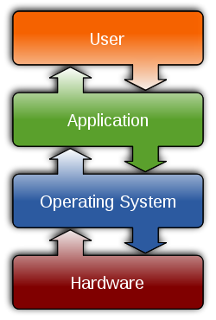

Outline
Using Tasks
Intro
Task – Topology
Task – Configuration
Swi vs. Task
Using Semaphores
Other Useful APIs…
Using Events
Dynamic Module Creation
Memory Footprint
Lab

Slide 4
Outline
Using Tasks
Intro
Task – Topology
Task – Configuration
Swi vs. Task
Using Semaphores
Other Useful APIs…
Using Events
Dynamic Module Creation
Memory Footprint
Lab

Slide 5
SYS/BIOS Thread Types (including Tasks)
Hwi
Hardware Interrupts
Hardware event triggers Hwi to run
BIOS handles context save/restore, nesting
Hwi triggers follow-up processing
Priorities set in silicon
Swi
Software Interrupts
Software posts Swi to run
Performs Hwi ‘follow-up’ activity (process data)
Up to 32 priority levels (16 on C28x/MSP430)
Priority
Task
Tasks
Usually enabled to run by posting a ‘semaphore’ (a task signaling mechanism)
Designed to run concurrently – pauses when waiting for data (semaphore)
Up to 32 priority levels (16 on C28x/MSP430)
Idle
Background
Runs as an infinite while(1) loop
Users can assign multiple functions to Idle
Single priority level
Task toplogy…
Notes:
Using Clock Fxns in a Task-based video system is not really recommended because Clock Functions will ALWAYS have a higher priority than TSKs because periodic functions s are prioritized as Swis.

Slide 6
Outline
Using Tasks
Intro
Task – Topology
Task – Configuration
Swi vs. Task
Using Semaphores
Other Useful APIs…
Using Events
Dynamic Module Creation
Memory Footprint
Lab

Slide 7
Task Code Topology – Pending
Void taskFxn(…)
{
/* Prolog */
while (‘condition’){
Semaphore_pend()
/* Process */
}
/* Epilog */
}
Initialization (runs once only)
Processing loop – (optional: cond)
Wait for resources to be available
Perform desired algo work...
Shutdown (runs once - at most)
Task can encompass three phases of activity
Semaphore can be used to signal resource availability to Task
Semaphore_pend() blocks Task until semaphore (flag) is posted
How do we configure a Task?

Slide 8
Outline
Using Tasks
Intro
Task – Topology
Task – Configuration
Swi vs. Task
Using Semaphores
Other Useful APIs…
Using Events
Dynamic Module Creation
Memory Footprint
Lab

Slide 9
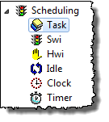

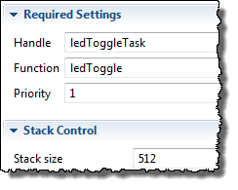
Configuring a Task – Statically via the GUI
Example: Create ledToggleTask, tie to ledToggle(), priority 1
1
Use Task module (Available Products) , Add new Task (Outline View)
2
Configure Task – Object name, function, priority, stack size:
Remember, BIOS objects can be created via the GUI, script code or C code (dynamic)
Can you change a Task's priority during runtime?
} System dependent

Slide 10
Modification of a Task’s Priority
origPrio = Task_setPri(Task_self(),7); // critical section ... // TSK priority increased or reduced ... Task_setPri(Task_self(),origPrio);
Task_setPri() can raise or lower priority (because Tasks have their own stack)
Return argument of Task_setPri() is previous priority
New priority remains until set again
Can also use Task_getPri() to get a Task’s current priority
To suspend a TSK, set its priority to negative one (-1)
Task removed from scheduler, can be re-activated with Task_setPri()
Handy option for statically created TSKs that don’t need to run at start
Tasks are ready to run when CREATED...

Slide 11
Thread Preemption Example
post swi1
return
post swi2
return
post sem2
return
post swi2
return
Hwi
post sem1
post sem2
return
Swi 2
return
return
Swi 1
pend sem2
pend sem2
pend sem2
interrupt
Task 2
Notice that Tasks run immediately when Scheduler starts…
pend sem1
pend sem1
Task 1
interrupt
interrupt
_start
Idle
interrupt
Events over time
Notes:
The main point of this slide is that BIOS (scheduler) manages priorities for you. Each thread (SWI, TSK) runs unaware of the others around it. As INTs post SEMs and SWIs, higher priority threads become ready, and BIOS will run each in order of priority, dropping down to lower levels as higher ones are satisfied or block waiting for additional resources. All this is automatic to the user - just write each thread, assign it a priority, and BIOS does the rest.
A few points to note: SWIs run to completion - like a function call - a one shot, if you like. TSKs, instead, usually linger much longer - their execute phase is a while loop. They block when they run out of resources, and lower threads (or idle) can run until the requested resource arrives. In Bridge, TSKs are dynamically created and can be deleted, but normally are ready, running, or blocked.
An interesting point: if RMS is a TSK of low priority (1), how come it’s running when TSK1 and TSK2 are ready? Recall that RMS implements the create phase of each TSK, and until the gateway puts the TSK in run mode, its priority is (minus) -1, thus TSK1 and TSK2 have no priority until elevated with DSPNode_run().

Slide 12
Task Object Concepts...
myTsk
fxn | *
environ | *
priority | 6
stack | *
name | lpf1
Task object:
Pointer to task function
Priority: changeable
Pointer to task’s stack
Stores local variables
Nested function calls
makes blocking possible
Interrupts run on the system stack
Pointer to text name of Task
Environment: pointer to user defined structure:
struct myEnv
Task stack
C fxn, eg: bk FIR
inst2
fxn | *
environ | *
priority | 6
stack | *
name | lpf2
struct myEnv
Task stack
Task_setenv(Task_self(),&myEnv);
hMyEnv = Task_getenv(&myTsk);

Slide 13
Outline
Using Tasks
Swi vs. Task
Using Semaphores
Other Useful APIs…
Using Events
Dynamic Module Creation
Memory Footprint
Lab

Slide 14
Swi vs. Task
Swi
Task
_post
void mySwi () {
// set local env
*** RUN ***
}
_create
void myTask () {
// Prologue (set Task env)
while(cond){
Semaphore_pend();
*** RUN ***
}
// Epilogue (free env)
}
“Ready” when POSTED
Initial state NOT preserved – must set each time Swi is run
CanNOT block (runs to completion)
Context switch speed (~140c for C6k)
All Swi’s share system stack w/Hwi
Use: as follow-up to Hwi and/or when memory size is an absolute premium
“Ready” when CREATED (BIOS_init or dynamic)
P-L-E structure handy for resource creation (P) and deletion (E), initial state preserved
Can block/suspend on semaphore (flag)
Context switch speed (~160c for C6k)
Uses its OWN stack to store context
Use: Full-featured sys, CPU w/more speed/mem
Notes:
If you call _pend in a Swi, an assertion causes an abort to occur. I guess you can technically call _pend with a timeout of ZERO, but don’t push it!!

Slide 15
Outline
Using Tasks
Swi vs. Task
Using Semaphores
Other Useful APIs…
Using Events
Dynamic Module Creation
Memory Footprint
Lab

Slide 16
Semaphore Pend
Semaphore_pend (Sem, timeout);
pend
false
Count > 0
true
timeout expires
Decrement count
Block task
SEM posted
Semaphore Structure:
Non-negative 16-bit counter
Pending queue (FIFO)
Return
FALSE
Return
TRUE
BIOS_WAIT_FOREVER | -1 | // wait forever
Zero | 0 | // don’t wait
value | timeout | // system ticks
How does _post work?

Slide 17
Semaphore Post
Post
Semaphore_post (Sem);
Task pending on sem?
False
True
Ready first waiting task
Increment count
Semaphore Structure:
Non-negative count
Pending queue (FIFO)
Return
Task switch will occur if higher priority task is made ready
How do you configure a Semaphore?

Slide 18
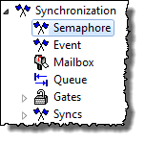

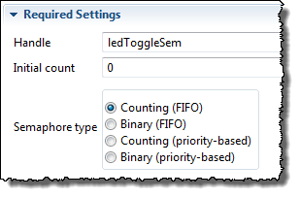
Configuring a Semaphore – Statically via GUI
Example: Create ledToggleSem, counting (FIFO)
1
Use Semaphore (Available Products) , insert new Semaphore (Outline View)
2
Configure Semaphore – Object name, initial count, type:
Shared Semaphores…

Slide 19
Shared Semaphores – FIFO…
INT!
post
Hwi
Enter (pend)
INT!
TSK Hi
BLOCKED !!
ACCESS
Enter (pend)
Exit (post)
TSK Lo
block
ACCESS
Pending threads are placed in a FIFO semaphore queue:
READY
TSK Lo
TSK Hi
…
Therefore, TSK Lo runs first. This is ok, but…
Priority Based Semaphores…
Notes:
Can use Task_setPri to temporarily raise the priority of the lower thread to the higher just before data access (discussed next). User can also use GateMutexPri which does the same thing…but is easier to use. Alas, if the threads are at the same priority, NONE of this crap happens….

Slide 20
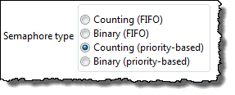
Priority-based Semaphores
INT!
post
Hwi
Enter (pend)
Exit (post)
INT!
TSK Hi
BLOCKED !!
ACCESS
Enter (pend)
TSK Lo
block
ACCESS
If you use (priority-based) type Semaphores, the higher Pri gets it:
Other useful APIs…
Hi runs first, but doesn’t fix “post” before “pend” case
Notes:
Can use Task_setPri to temporarily raise the priority of the lower thread to the higher just before data access (discussed next). User can also use GateMutexPri which does the same thing…but is easier to use. Alas, if the threads are at the same priority, NONE of this crap happens….

Slide 21
Outline
Using Tasks
Swi vs. Task
Using Semaphores
Other Useful APIs…
Using Events
Dynamic Module Creation
Memory Footprint
Lab

Slide 22
SYS/BIOS Semaphore/Task APIs
Other useful Semaphore APIs:
Semaphore_getCount() Get semaphore count
Other useful Task APIs:
Task_sleep () Sleep for N system ticks
Task_yield () Yield to same pri Task
Task_setPri() Set Task priority
Task_getPri() Get Task priority
Task_get/setEnv () Get/set Task Env
Task_enable() Enable Task Mgr
Task_disable() Disable Task Mgr
Task_restore() Restore Task Mgr

Slide 23
Outline
Using Tasks
Swi vs. Task
Using Semaphores
Other Useful APIs…
Using Events
Dynamic Module Creation
Memory Footprint
Lab

Slide 24
Using Events – Explicit Post/Pend
Evt Obj
Hwi 5
Post EV0
EV0
EV1
EV2
EV3
EV4
…
EV31
myTask
mask = EV0 + EV2 + EV4;
while(1)
{ // “simplified” ver
Event_pend (mask);
// do work
}
Hwi 7
Post EV2
AND
Post EV4
OR
Hwi 9
Semaphore_pend()only waits on one flag – a semaphore.
What if you want to “unblock” based on multiple events?
Use Events. Can OR or AND event IDs with bit masks
Events are “binary semaphores”. Only one Task can block on an Evt object at a time (can’t use as “mutex”).
The key “Explicit Post” and Pend APIs are:
What about "implicit posts" ?
Event_post (&Evt, Event_Id_xx);
Event_pend (&Evt, andMask, orMask, timeout);
Notes:
If both an andMask and an orMask are used, they are OR’d together.

Slide 25
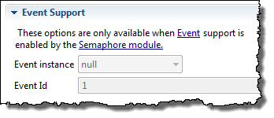
Implicit “Event Post”
Evt Obj
Semaphore
Post EV0
EV0
EV1
EV2
EV3
EV4
…
EV31
myTask
mask = EV0 + EV2 + EV4;
while(1)
{ // “simplified” ver
Event_pend (mask);
// do work
}
Mailbox
Post EV2
AND
Post EV4
OR
MessageQ
Other APIs, as shown above, can also post events – implicitly – the eventId is part of the params structure (e.g. Semaphore):
Specify Event Id here…
So, even a standard Semaphore_post(Sem) can post an event !
Note: see “Event” example under SYS/BIOS Templates
Notes:
Writing semaphore init’d to mailbox length. Reading semaphore count init’d to zero.

Slide 26
Outline
Using Tasks
Swi vs. Task
Using Semaphores
Other Useful APIs…
Using Events
Dynamic Module Creation
Memory Footprint
Lab

Slide 27
Dynamically Creating Kernel Objects
Module_create
Allocates memory for object out of heap
Returns a Module_Handle to the created object
Module_delete
Frees the object’s memory
Example: Semaphore creation/deletion:
Modules
Hwi
Swi
Task
Semaphore
Stream
Mailbox
Timer
Clock
List
Event
Gate
#define COUNT 0
Semaphore_Handle hMySem;
hMySem = Semaphore_create(COUNT,NULL,&eb);
Semaphore_post(hMySem);
Semaphore_delete(&hMySem);
params
C
X
D
Note: always check return value of _create APIs !
Notes:
NULL is the Attrs structure for this creation.

Slide 28
Example – Dynamic Task API
Task_Handle hMyTsk;
Task_Params taskParams;
Task_Params_init(&taskParams);
taskParams.priority = 3;
hMyTsk = Task_create(myCode,&taskParams,&eb); // “MyTsk” now active w/priority = 3 ...
Task_delete(&hMyTsk);
C
X
D
taskParams includes: heap location, priority, stack ptr/size, environment ptr, name
Notes:
Why taskParams? It sets the defaults if you don’t. Plus, you can change those defaults (like priority above). Also, it opens up the ability for adding new features (params) in the future with the same C code.

Slide 29

Using System_printf()
Need to print to the Console Window when something bad happens?
If you don’t get a handle to a resource (bad), you can use this API to send a report when BIOS exits:
System_printf(“buf: no resource\n");
Uses the SysMin Module:
Outputs results to Console window when a System_flush() occurs (like when BIOS exits) or _flush is called
Offers similar flexibility as printf() for a smaller footprint
Can be called by an ISR (Hwi)
Notes:
You will see this API used in many SYS/BIOS examples. Does NOT require RTA Agent. Just SysMin and results are not sent to Console until a System_flush() is called – like BIOS_exit(0). System_printf() is a 2400 cycle API (out of IRAM on the C6000). Still pretty big. Only use when system is aborting anyway. FYI – Log_info is only 40 cycles. HOO-HA !!

Slide 30
Outline
Using Tasks
Swi vs. Task
Using Semaphores
Other Useful APIs…
Using Events
Dynamic Module Creation
Memory Footprint
Lab

Slide 31
Memory Footprint (MCU Targets)
Application Baseline Footprints – Non-BIOS vs. BIOS (MIN)
Application | FLASH (prog) in bytes |  |  | RAM (data) in bytes
BLINK LED Using xWare | MSP430 | C28x (w) | Tiva-C | MSP430 | C28x (w) | Tiva-C
BASE – No BIOS (Lab 2, Blink LED) | 1658 | 1364 | 2032 | 1026 | 1313 | 1046
+ BIOS + IDLE (and IDLE fxn) | 4874 | 4034 | 8075 | 1180 | 1668 | 2318
+ Hwi | 4886 | 4370 | 8083 | 1194 | 1732 | 2342
+ Swi (incl Hwi and Swi_post) | 5790 | 4807 | 8199 | 1390 | 1796 | 2390
+ Task/Sem (incl Hwi to post Sem) | 8488 | 6507 | 11161 | 2682 | 2500 | 4732
+ UIA to Task/Sem application (default buffer sizes used) | 15520 | 9595 | 15733 | 6088 | 5706 | 8272
All BIOS applications used “MIN” BIOS CFG (modified from the BIOS U/G – Appendix D) plus whatever objects, code and stack that were necessary (projects available in TI-RTOS folder)
All applications include a 1K user (system) stack (for Hwi/Swi)
All applications used the RELEASE build configuration (for source files)
No heap (dynamic memory allocation turned off)
All BIOS builds used “custom” optimizations which is the default for BIOS libraries
Task/Idle stacks – defaults used (MSP430: 512B, C28x: 256B, TM4C: 1K)
Tiva-C: exception handling turned OFF (commented in .cfg file used in project)
C28x FLASH vs. RAM - .map file (FLASH = FLASH, RAM = M0-1 + L0-6), boot ROM tables excluded

Slide 32
Outline
Using Tasks
Intro
Task – Topology
Task – Configuration
Swi vs. Task
Using Semaphores
Other Useful APIs…
Using Events
Dynamic Module Creation
Memory Footprint
Lab

Slide 33

Labs 5-9 “Roadmap”
Lab | Trigger | Hwi | Other | Fxn
5 | h/w timer | BIOS Hwi ledToggle
5B | BIOS timer ledToggle (Hwi)
6 | h/w timer | BIOS Hwi | BIOS Swi ledToggle
7 | BIOS Clock ledToggle (Hwi, Swi)
8 | h/w timer | BIOS Hwi | BIOS Task ledToggle
9 | h/w timer | BIOS Hwi | LED State → Mbx/Que →ledToggle

Slide 34

Lab 8 – “Blink LED” Using Task
Lab Goal:
The Hwi’s ISR will now post a SEMAPHORE to unblock a Task
Procedure
Import archived (.zip) project (from Swi lab)
Add Task object (for ledToggle)
Build, “Play”, Debug
Use ROV/UIA to debug/analyze
Replace Hwi, Sem, Timer with Task_sleep()
[OPTIONAL] (create Sem/Task dynamically)
main.c
main() {
init_hw();
Timer (500ms)
BIOS_start();
}
Scheduler
Hwi
Semaphore_post(LedSem);
Hwi ISR
Task
ledToggle() {
while(1) {
Semaphore_pend(LedSem);
Toggle_LED;
}
}
ledToggleTask
Idle
Time: 17.35 min

Slide 35


Slide 36
Outline
MainHighlight
MainNormal
SubHighlight
SubNormal

